Slide 1

Anna University IoT Workshop
IOT Workshop Prep-Book
Your Pre-Workshop Setup Guide — Get Ready to Build!
Hi guys! Super excited to have you all at the workshop. This guide walks you through everything — step by step — so on workshop day you just plug in your ESP32 and start coding. No stress, promise!
Anna University IoT Workshop | September 2026

Slide 2





What You Will Need Before You Start
Your Windows Laptop
Windows 10 or Windows 11 — both are fine
A Stable Internet Connection
Needed to download software and board packages
About 20–25 Minutes of Free Time
Set aside some time to go through this guide without rushing
You're Ready to Build!
Once these are sorted, the fun part begins on workshop day
Your ESP32 Development Board (Will be provided)
30-pin ESP32 with Micro-USB interface

Slide 3





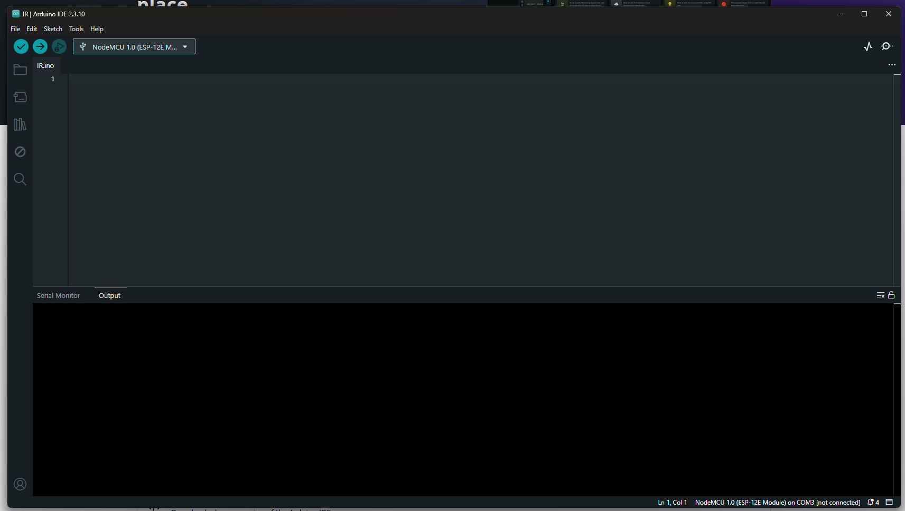
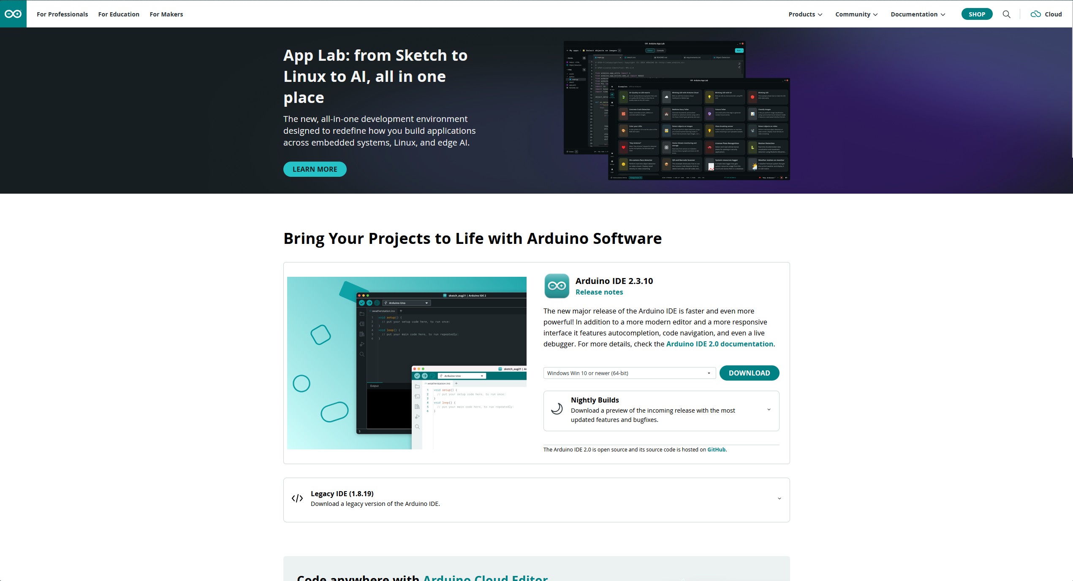

Step 1 — Download and Install Arduino IDE
Arduino IDE 2.x is the modern standard — download it once and you are set for the entire workshop.
1
2
3
4
Go to http://www.arduino.cc/en/software and download the latest Arduino IDE 2.x installer for Windows.
Run the downloaded .exe file — click through the install wizard
When Windows asks about allowing app changes — click Yes
Launch Arduino IDE — if it opens without errors, you are good to move on!
Next → Agree → Install → Finish
Pro tip: As of 2026, Arduino IDE 2.x is the recommended standard for all ESP32 projects.

Slide 4
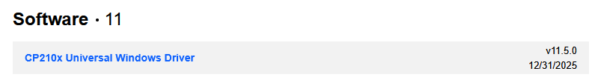
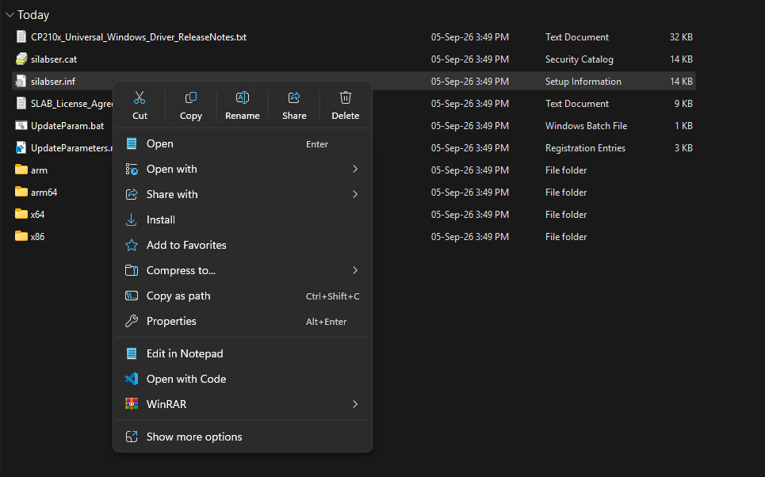
Step 2 - Install the CP2102 USB Driver
Without this driver, your laptop will never see your ESP32 — this is the most important step.
1
Most ESP32 boards use a CP210x USB-to-UART bridge chip (Silicon Labs) to communicate with your laptop.
2
If the driver is missing, your board will not appear in Device Manager and no COM port will show in Arduino IDE.
3
Download the driver: go to SILABS.COM (Link is embedded in this text) and download the package named :
v
4
Extract the contents of the zip file, right click silabser.inf and click on install
Agree to the upcoming dialog boxes. Restart your laptop

Slide 5



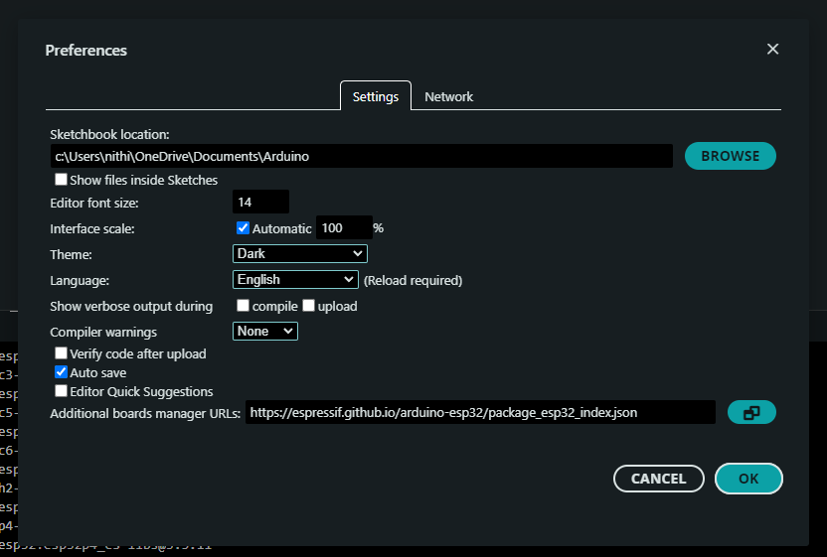


Step 3 — Add the ESP32 Board Manager URL
This one URL is the key that unlocks ESP32 support inside Arduino IDE.
1
2
3
4
Open Preferences
Paste the URL
Save Settings
You're Set!
Open Arduino IDE → go to File → Preferences.
Find "Additional boards manager URLs" and paste this URL exactly:
Click OK to save your preferences
Arduino IDE now knows where to find the ESP32 board package — like telling Arduino where to go shopping for ESP32 stuff!
https://espressif.github.io/arduino-esp32/package_esp32_index.json
Next up: we'll actually download and install the ESP32 board package in Step 4.

Slide 6





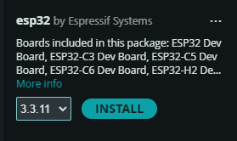
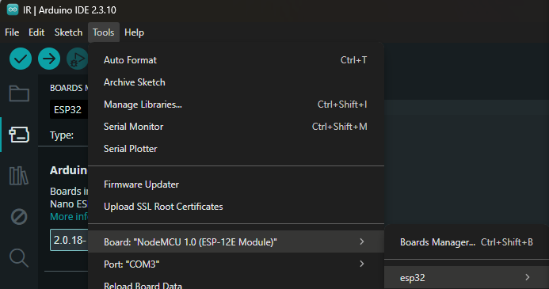


Step 4 - Install the ESP32 Board Package
Installing the board package is what lets Arduino IDE compile and upload code to your ESP32.
v
1
2
3
4
5
Open Boards Manager
Search for ESP32
Install the Package
Wait for Download
Select Your Board
Go to Tools → Board → Boards Manager.
In the search box, type
esp32
Find esp32 by Espressif Systems → click Install [2]
This can take a few minutes — grab a snack while it installs
Go to Go to Tools → Board Now esp32 should be visible

Slide 7


Quick Pre-Workshop Checklist
Run through this list the night before the workshop — if all boxes are checked, you are fully ready.
Arduino IDE 2.x installed and opens without errors
CP2102 driver installed
ESP32 board manager URL added in Preferences
"esp32 by Espressif Systems" installed via Boards Manager
Tick every box above and you are 100% workshop-ready — see you there!

